Slide 1
Hungarian Research Teachers’ Association
Introduced by:
Mónika Réti
… where creativity and volition multiply

Slide 2
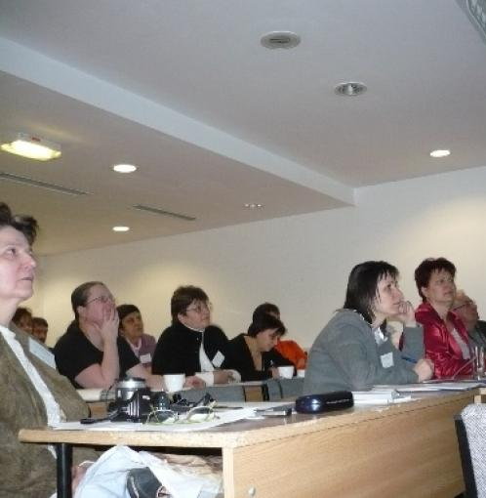
Only teachers?
> 200 members, from the Carpathian basin
All types of settlements represented
Most school types and all educational levels represented

Slide 3
What do they research?
Research projects with students
Educational research and didactics
Individual academic research

Slide 4
Why are they allied?
Recognition of work done by peers
Supportive community with co-creation
Chance for shaping attitudes and making their voices heard

Slide 5
What do they do?
Regular programs
Projects
Professional communities – e.g.: JOKER (Gamification in Education Framework)
Annual conference: Learning from each other
Annual conference: Learning from others
Broadening the horizon of science teaching and learning in Hungary
Ark of Inquiry
Rounder Sense of Purpose
Urban Science

Slide 6
Some professional partners
Hungarian Academy of Sciences
Hungarian Innovation League
Universities in Hungary and around the world (Amsterdam, Barcelona, Berlin, Bristol, Cheltenham, Copenhagen, Glasgow, Helsinki, Istambul, Kiel, Klagenfurt, Kuala Lumpur, Lyon, Nicosia, Oslo, Santiago de Compostela, Seoul, Tartu, Trondheim, Turku, Zürich, …)
International organisations: UNESCO, IUCN
Private companies, NGOs and professional institutions
Environmental and School Initiatives (ENSI)

Slide 7
Numbers
11 years of continuous operation
> 300 members
23 major conferences organised for members
31 teacher training courses (free of charge for members)
3 international conferences, with participants from 25 countries
4 prizes established, 37 laurates between 2007 - 2017
5 + 1 major international projects
5 + 3 national projects

Slide 8
Why is it good?
https://youtu.be/331KxifWudQ

Slide 9
Let’s meet!
Look at us:
www.kuttanar.hu
Contact us:
reti.kuttanar@gmail.com
Thank you for your kind attention

