Slide 1
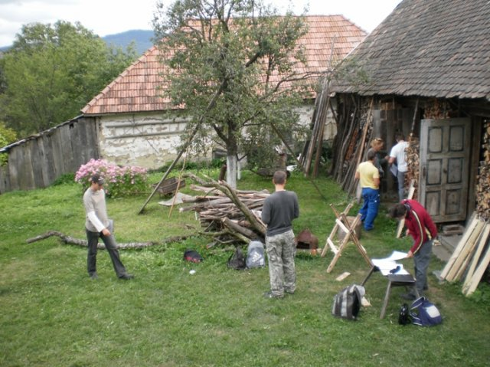
The challenges of school community collaboration for SD/ESD How houses can build bridges
CoDeS Conference, Vienna
1 May, 2012

Slide 2
Who’s who
Presenters:
Tamás Józsa, principal of Hild Secondary School
Anett Bodányi, student at Hild Secondary School
Edit Lippai, Working Group for Environmental Communication
Ildikó Lippai, Hungarian Research Teachers’ Association
Mónika Réti, Hungarian Institute for Educational Research and Development
Facilitator:
Günther Pfaffernwimmer, Austrian Federal Ministry for Education, Arts and Culture
Raporteur:
Nina Elisabeth Høgmo, Norwegian Centre for Science Education, University of Oslo

Slide 3
Outline
15.00 – 15. 25 Brief presentation of the case
15.25 – 16.00 Exhibition
16.00 – 16.10 break
16.10 – 16.55 Groupwork: communication tools
16.55 – 17.05 break
17.05 – 17.25 Groupwork: transforming the case
17.25 – 17.50 Reflexions
17.50 – 18. 00 Wrapping up

Slide 4
Leading questions
What are the perspectives of different stakeholders? What other information is needed to understand stakeholders’ perspectives?
What challenges/learning does school community collaboration for SD/ESD have?
What tensions drive changes in this case?
What challenges are different stakeholders facing in this particular case?
What other challenges can we identify from participants’ own experiences which are relevant to this case?

Slide 5
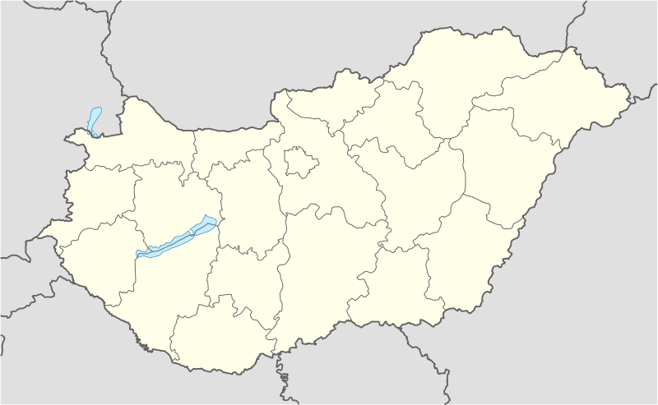
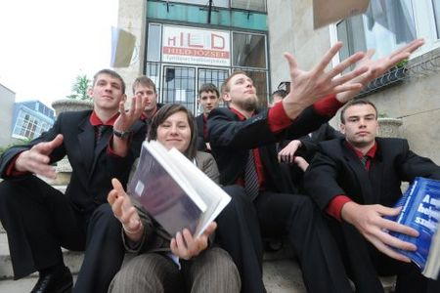
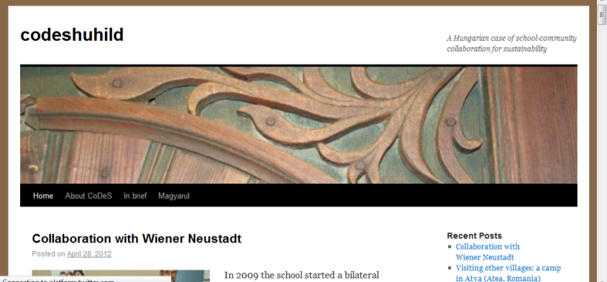
The case
Hild József Építőipari Szakközépiskola
folk architecture
case blog:
http://codeshuhild.com
the city of Győr
130 km west of Budapest
Population: 131.000

Slide 6
Links to sustainability
local culture
traditional knowledge
intergenerational dialogue
mutual learning
use of natural materials
lifestyles: in harmony with nature
back to nature/ eco approach
professional skills
modern techniques and knowledge (ICT)
marketing
„scientific” explanation

Slide 7
Main actors
School – initiator
Principal
Teachers and school staff
Students
Parents
Former students
City of Győr
Villages in region
Other villages
Local authorities
Local communities
Experts
Other authorities
Other schools
Professional Networks
Media
Perspectives:
learning
sharing
conserving
rebuilding
Aspects:
local-wider
personal-professional
community
old-new

Slide 8
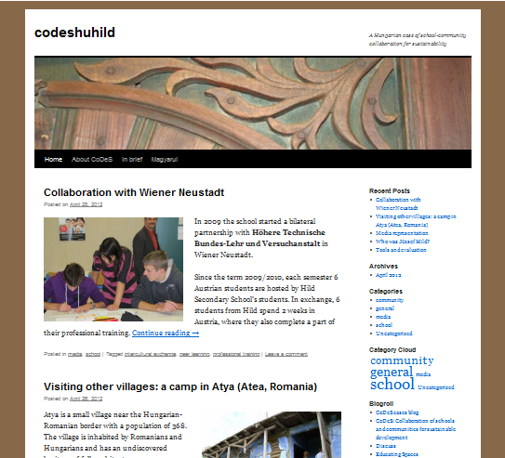
More about this:
http://codeshuhild.com
http://hildszki.hu

Slide 9
Leading questions
What are the perspectives of different stakeholders? What other information is needed to understand stakeholders’ perspectives?
What challenges/learning does school community collaboration for SD/ESD have?
What tensions drive changes in this case?
What challenges are different stakeholders facing in this particular case?
What other challenges can we identify from participants’ own experiences which are relevant to this case?

